Slide 1
J K K NATTRAJA COLLEGE OF ENGINEERING AND TECHNOLOGY
TEAM MEMBERS:
JAE DIVYA S
MADHUMITHA R
GOMATHI K
SATHYA DEVI P
MENTOR:
MURUGASHANKAR S

Slide 2
Design and Innovation Proposal:
Product Demand Prediction with Machine Learning.
ABSTRACTION
predicting product demand is a crucial task for businesses to optimize their inventory and supply chain management. machine learning provides a powerful tool to analyze historical sales data and predict future demand with high accuracy. this guide will provide a comprehensive overview of the process and techniques involved in product demand prediction with machine learning.

Slide 3
Problem Statement:
Accurately predicting product demand is crucial for businesses to optimize inventory management, production planning, and supply chain operations. traditional forecasting methods often struggle to capture the complex relationships and dynamic patterns in demand data. there is a need for an innovative machine learning solution that can leverage advanced techniques to provide accurate and actionable demand predictions.

Slide 4
Data Collection and Preparation
The first step in product demand prediction is to collect and prepare the data. this involves gathering historical sales data, along with any relevant external factors such as seasonality or marketing campaigns. the data should be cleaned and preprocessed to ensure it is in a suitable format for machine learning algorithms.

Slide 5
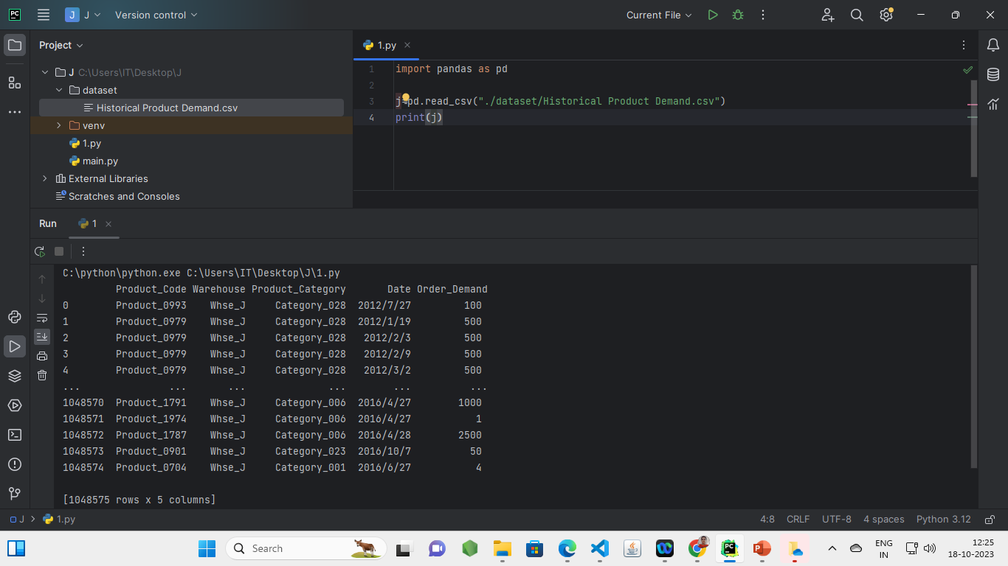
PROGRAMMING CODE BEFORE PREPROCESSING.

Slide 6
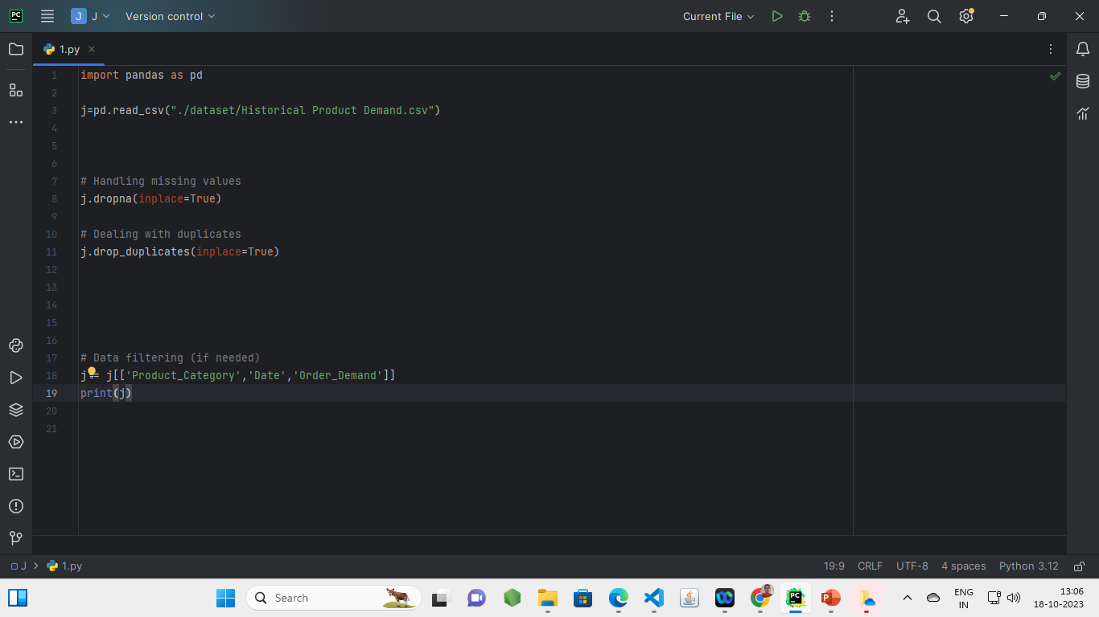
PROGRAMMING CODE AFTER LOADING AND PREPROCESSING.

Slide 7
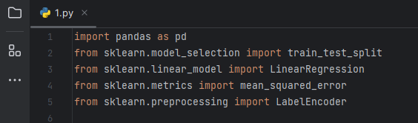
IMPORTING TEST PACKAGE

Slide 8
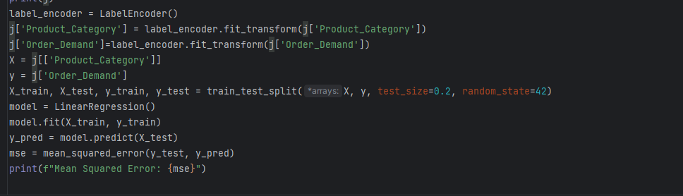
CODE:

Slide 9
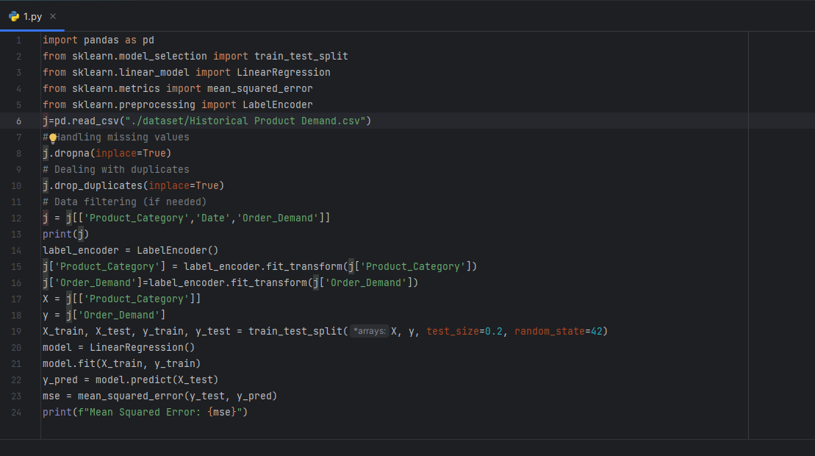
ENTIRE CODE FOR THE PROJECT

Slide 10
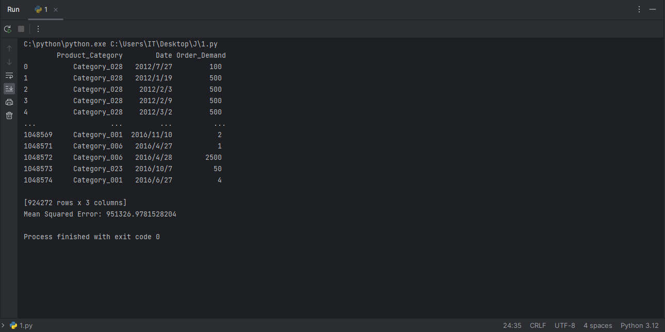
OUTPUT

Slide 11
SOURCE:
Product demand prediction with machine learning with the use of Kaggle.
USED SOFTWARE FOR PROGRAMMING:
pycharm with installed pandas.

Slide 12
THANK YOU…

